Slide 1
Google Ads Facebook Ads Analytics Reporting 2020

Slide 2
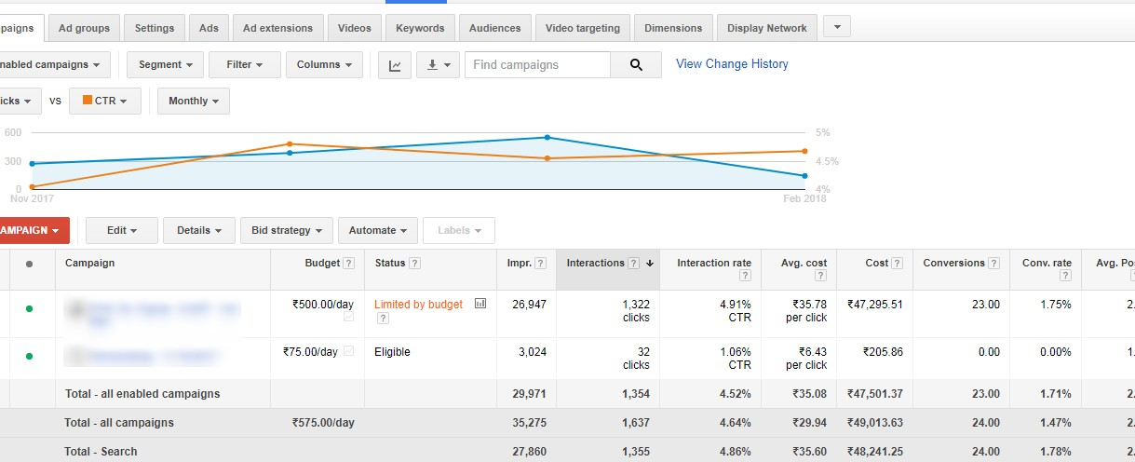
Google Ads Campaign - I

Slide 3
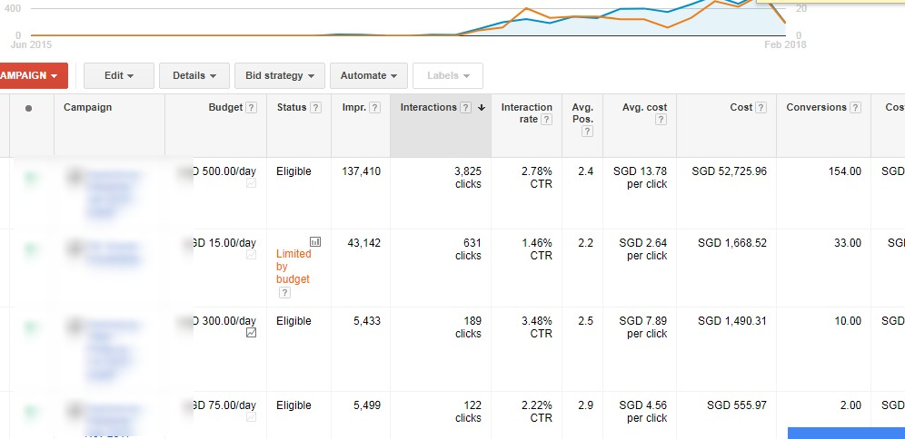
Adwords Campaign II

Slide 4
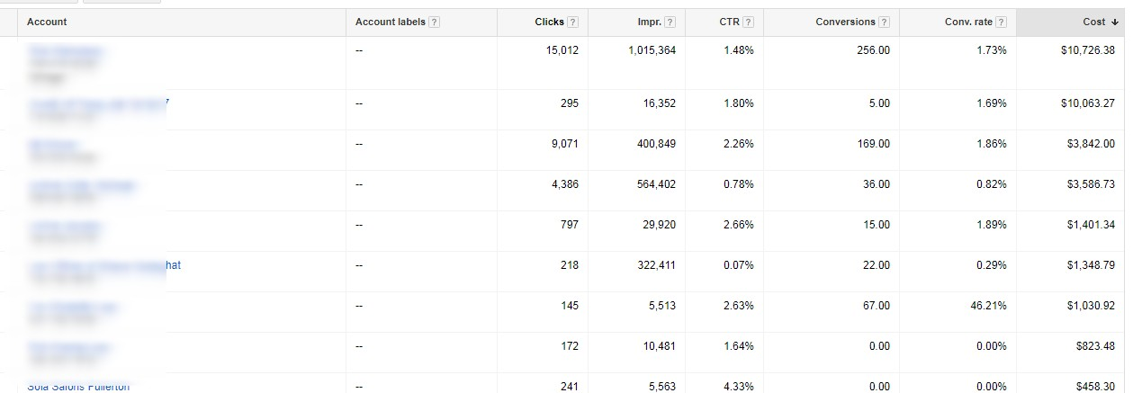
Google Ads Spending

Slide 5
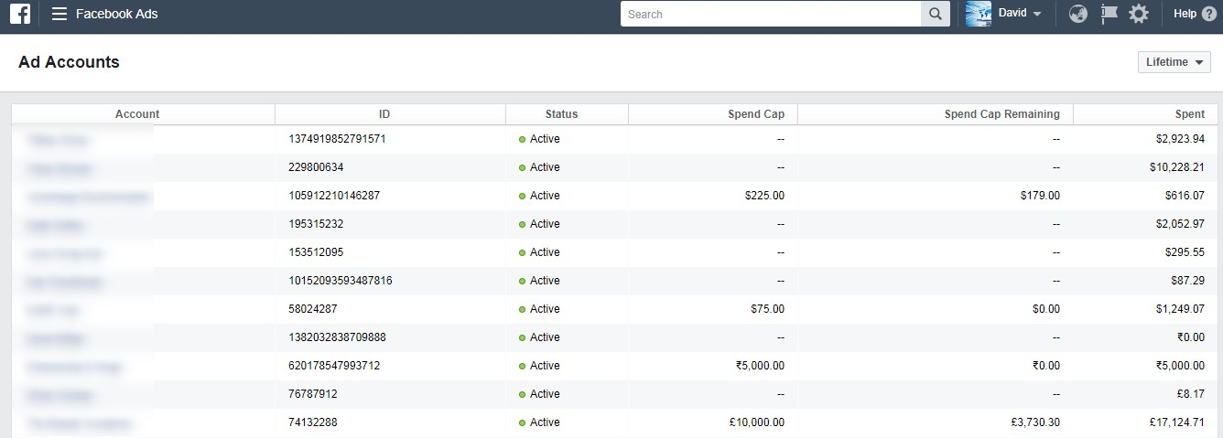
FB Ads Spending

Slide 6

FB Ads 1

Slide 7
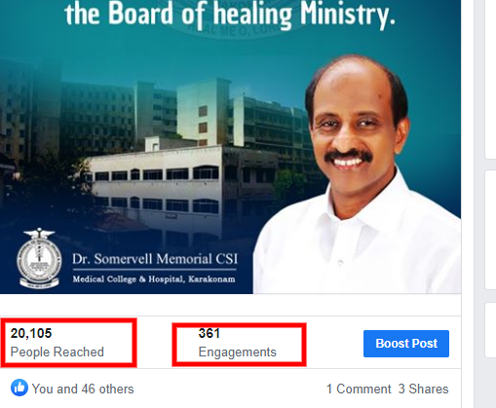
FB Ads 2

Slide 8
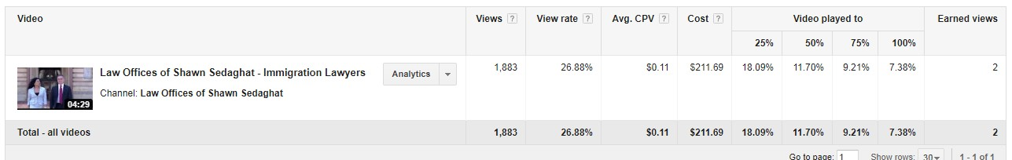
Youtube Ads Analytics

Slide 9
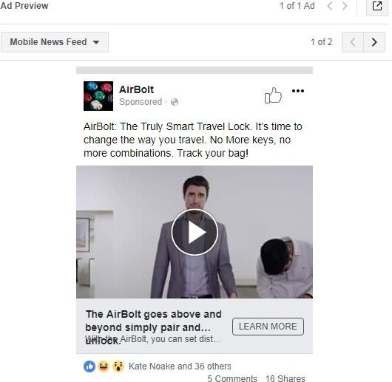
FB Video Ads

Slide 10
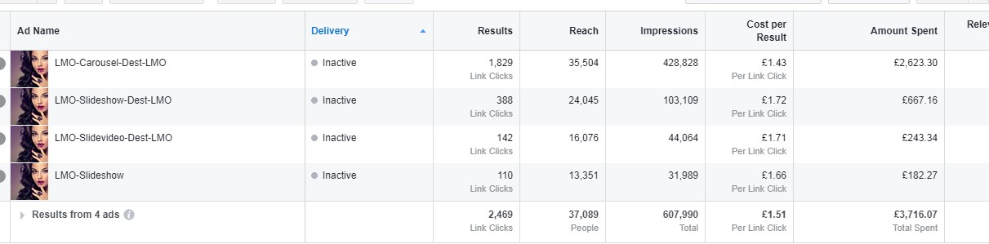
FB Ads Screenshot

Slide 11
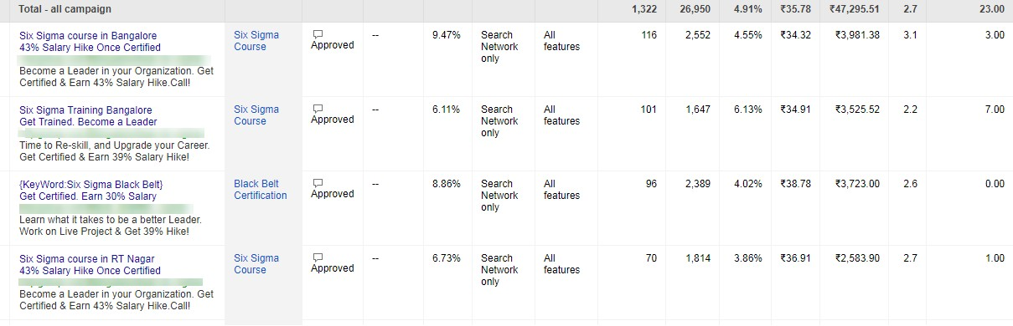
Adwords Ads

Slide 12
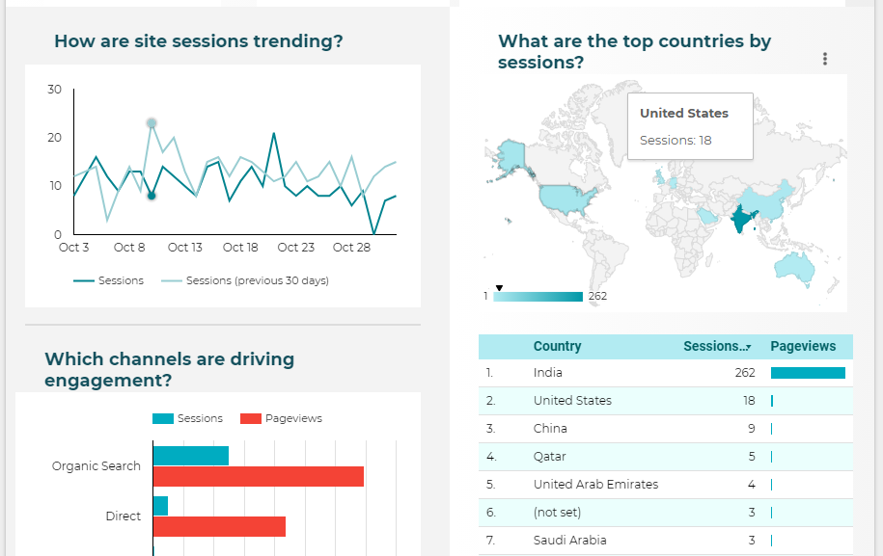
Data Visualization
https://datastudio.google.com/s/pB49WM7yy_Y

Slide 13
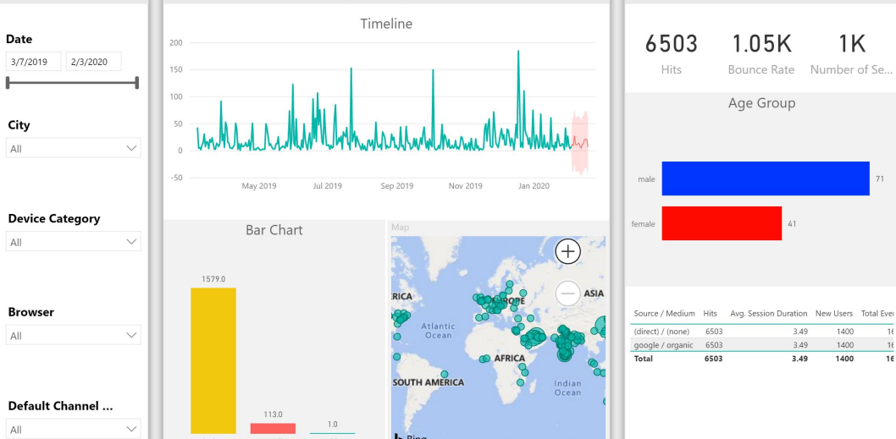
Data Visualization

Slide 14
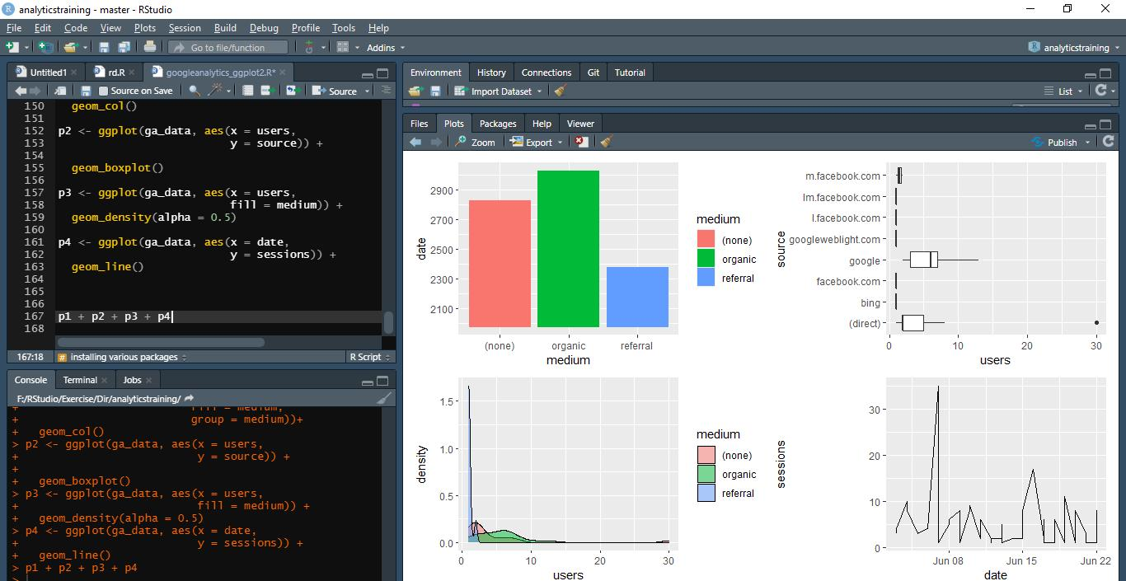
Data Visualization
https://www.dropbox.com/s/1gqouiuewikn1aj/ggplot2.pdf?dl=0

